Slide 1
Easley Inventory System
Home inventory management

Slide 2
Introduction
Nobody wants to see it happen to them, but burglaries happen all the time!
Are you prepared with an inventory of what is in your home?
Is it complete with everything the insurance company and police will need?

Slide 3
Overview of Project
The “Easley Inventory System” allows home owners to quickly track their most valuable purchases.
Currently it tracks:
Asset Names
Purchase Dates, Prices, and Locations
Pictures of the asset items

Slide 4
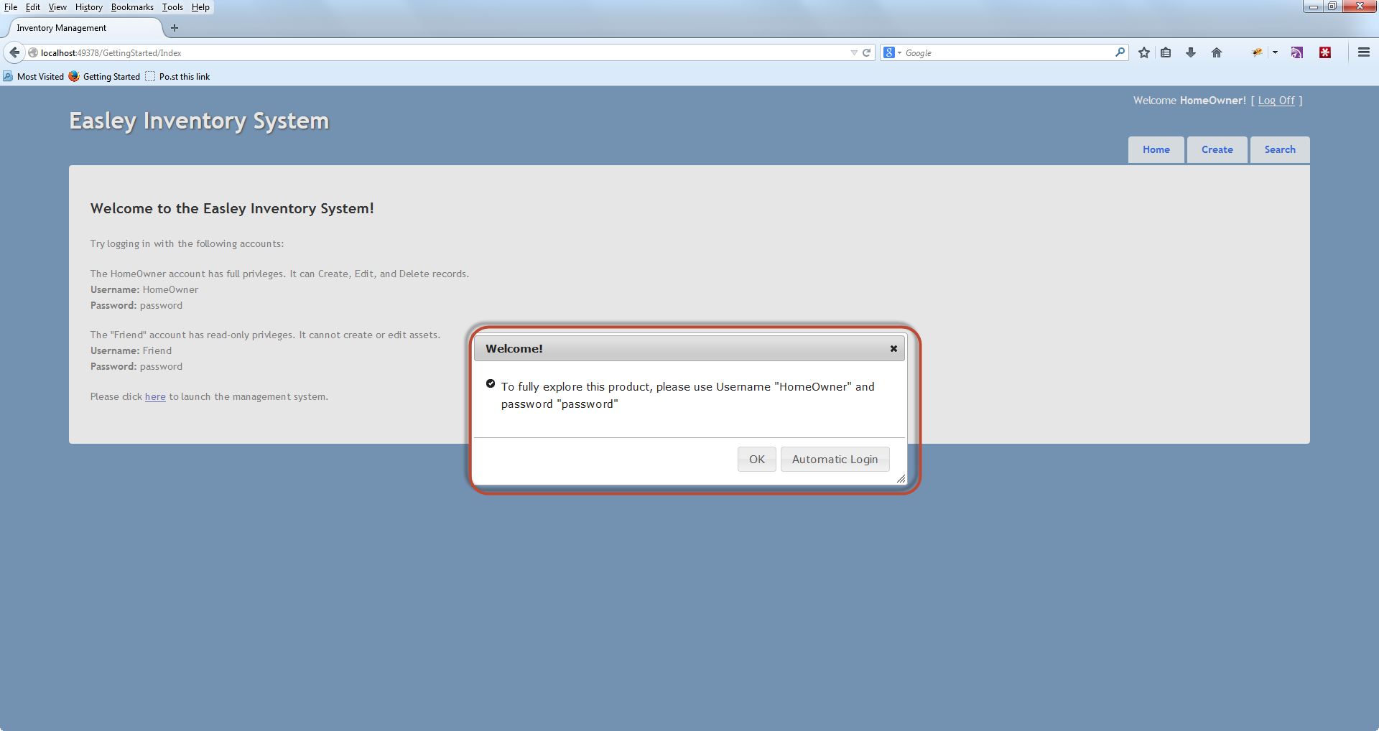
Modern jQuery UI Dialog windows

Slide 5
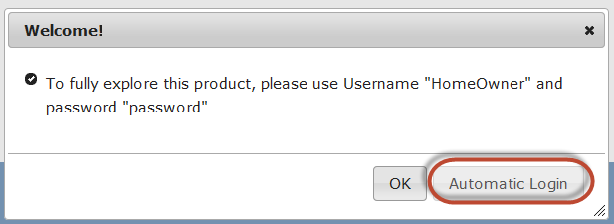
Automatic login as admin feature
The automatic Login as Admin feature makes demonstrating the product easy.

Slide 6
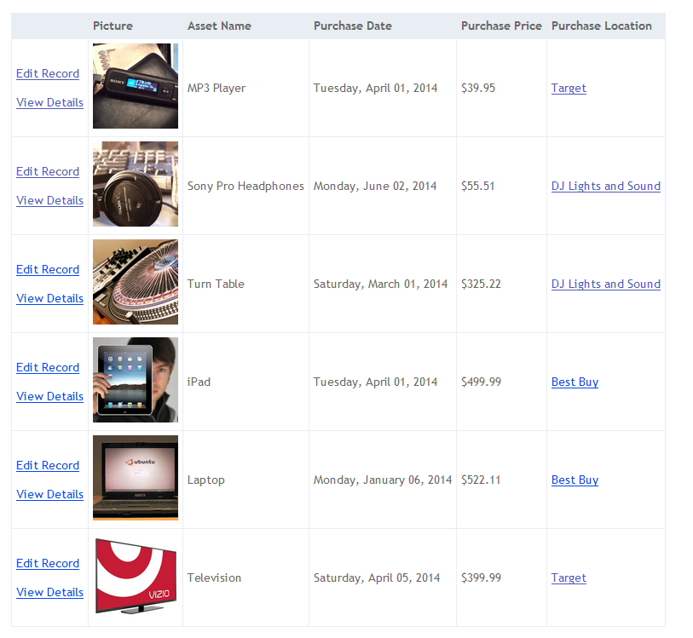
At a Glance Asset View

Slide 7
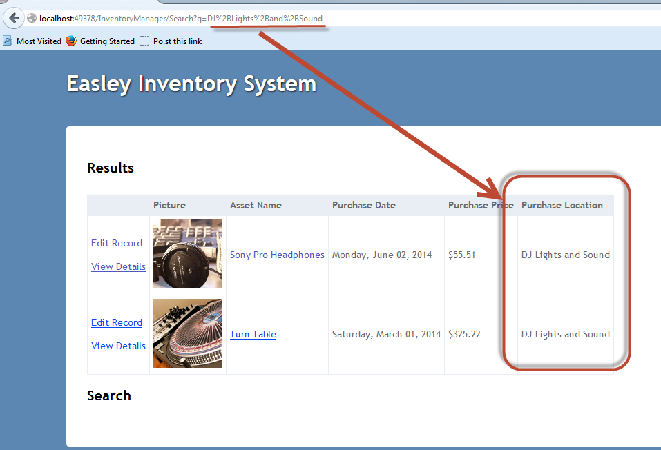
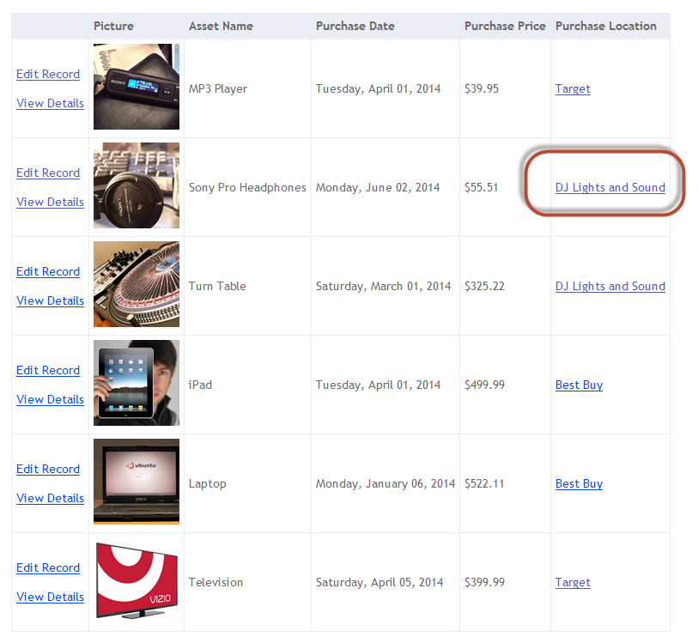
Drill down searching
Filter the “At a Glance” view by clicking on a purchase location.
All assets purchased from that location are shown.
Securely searches using Html Encoding

Slide 8
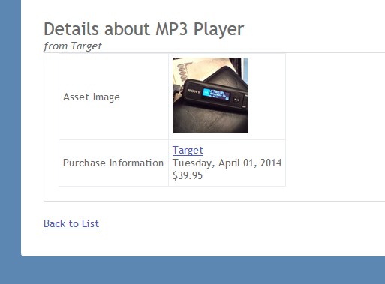
Details Page
Even the DETAILS page allows you to
see inventory items purchased from the same location!

Slide 9
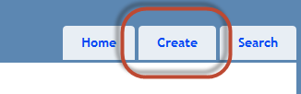
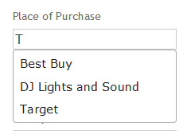
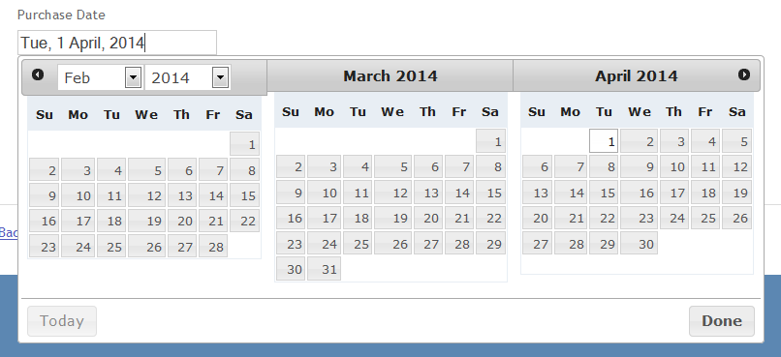
Quick asset creation
Access CREATE page from anywhere in the application
Quickly add assets using AJAX enable searching
Calendar Features too!

Slide 10
Most difficult Challenges
Asp.NET is vastly different from the experience this author had with Web Forms.
Asp.NET is case sensitive and uses @Model and @model to mean different things.
Trying to seed the database anywhere other than Application_Start is a bad idea. The intent was to create two databases (a Clean database with basic information, and a Demo database with all records populated.) This did not work out.

Slide 11
Easiest process
Unit Testing was the most fun, and easiest component of all. Unit Tests in this project include 40+% code coverage!
jQuery UI was a breeze to implement, and at times easier than the MVC components themselves.
Given enough time, the entire site would be updated to use jQuery UI.

Slide 12
Lessons learned
When a feature isn’t working out, cut it, and implement a simpler alternative. The more advanced feature can always be added back in later.
Functionality is more important than form. An ugly website is more accepted than a malfunctioning one.
Always backup your work. Use a Source Control Management (SCM) system like GitHub to ensure multiple revisions are available. Hard drive failure occurred mid-project.

Slide 13
conclusion
ASP.NET MVC has amazing “Code First” capabilities that make database design a breeze.
ASP.NET MVC can be secure by default, with some basic coding practices.
Function is more important than form.
Visual Studio 2013 is much more helpful than 2012 was. Upgrading the project was the best action item taken.

